Slide 1
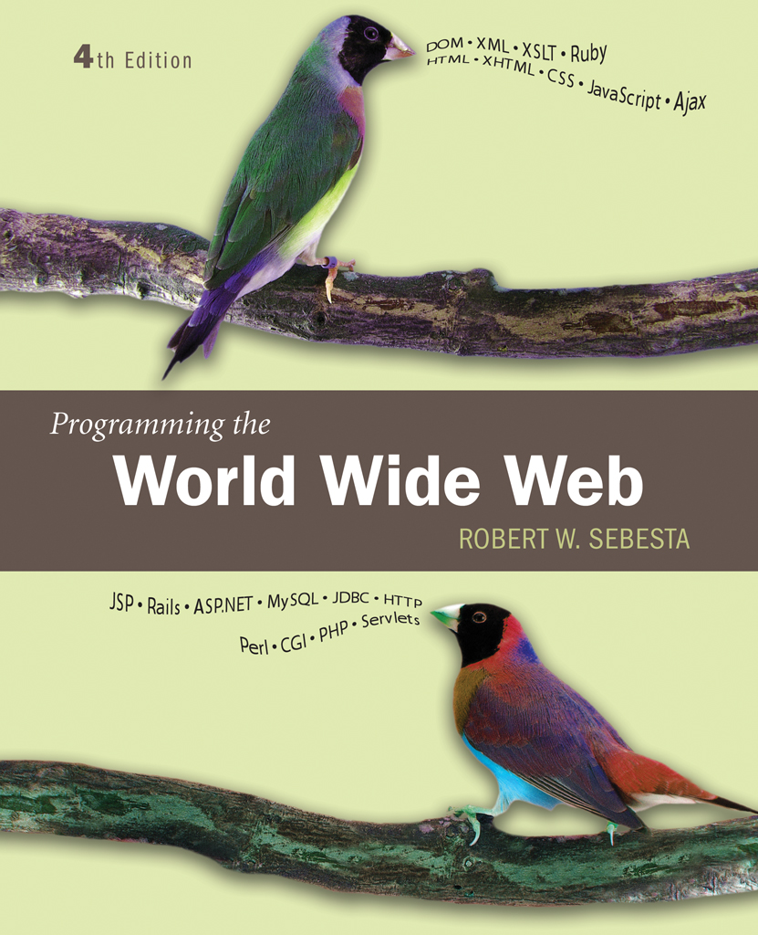
Chapter 4
Basics of
JavaScript

Slide 2
JavaScript/EcmaScript References
The official EcmaScript, third edition, specification
  http://www.ecma-international.org/publications/files/ECMA-ST/Ecma-262.pdf
A working version of the 4th edition of the EcmaScript language specification
  http://www.carsoncheng.com/Ecma/tc39-tg1-2006-001.pdf
JavaScript as implemented in Mozilla products
  http://developer.mozilla.org/en/docs/JavaScript
Edition details can be found at the following site
  http://en.wikipedia.org/wiki/ECMAScript#cite_note-jsmoz-12
Details on how the browser and the engines work is given in the following site
  http://www.quora.com/JavaScript/How-does-a-JavaScript-engine-work#

Slide 3
4.1 Overview of JavaScript: Origins
Originally developed by Netscape as LiveScript
Joint Development with Sun Microsystems in 1995
Standard 262 (ECMA-262) of the European Computer Manufacturers Association
Supported by Netscape, Mozilla, Internet Explorer

Slide 4
Browsers, JavaScript and ECMA editions
Application | Latest version | ECMAScript edition
Google Chrome, the V8 engine | JavaScript | ECMA-262, edition 5
Mozilla Firefox, the Gecko layout engine, SpiderMonkey, and Rhino | JavaScript 1.8.5 | ECMA-262, edition 5
Safari, the Nitro engine | JavaScript | ECMA-262, edition 5.1

Slide 5
4.1 JavaScript Components
Core
  The heart of the language
Client-side
  Library of objects supporting browser control and user interaction
Server-side
  Library of objects that support use in web servers
Text focuses on Client-side

Slide 6
4.1 Java and JavaScript
Differences
  JavaScript has a different object model from Java
  JavaScript is not strongly typed
  Objects are dynamic in JavaScript
Java 1.6 has support for scripting
  http://java.sun.com/javase/6/docs/technotes/guides/scripting/index.html
SpiderMonkey is the code name for the first-ever JavaScript engine, written by Brendan Eich at Netscape Communications
Mozilla Rhino is an implementation of JavaScript in Java
  http://www.mozilla.org/rhino/

Slide 7
4.1 Uses of JavaScript
Provides alternative to server-side programming
  Servers are often overloaded
  Client processing has quicker reaction time
JavaScript can work with forms
JavaScript can access and modify the CSS properties and content of any element of a displayed XHTML document
JavaScript is used to provide more complex user interface than plain forms with HTML/CSS can provide
JavaScript can be used as a replacement to Java applets

Slide 8
4.1 Event-Driven Computation
Users actions, such as mouse clicks and key presses, are referred to as events
The main task of most JavaScript programs is to respond to events
For example, a JavaScript program could validate data in a form before it is submitted to a server
  Caution: It is important that crucial validation be done by the server. It is relatively easy to bypass client-side controls
  For example, a user might create a copy of a web page but remove all the validation code.

Slide 9
4.1 XHTML/JavaScript Documents
When JavaScript is embedded in an XHTML document, the browser must interpret it
Two locations for JavaScript server different purposes
  JavaScript in the head element will react to user input and be called from other locations
  JavaScript in the body element will be executed once as the page is loaded
Various strategies must be used to ‘protect’ the JavaScript from the browser
  For example, comparisons present a problem since < and > are used to mark tags in XHTML
  JavaScript code can be enclosed in XHTML comments

Slide 10
4.2 Object Orientation and JavaScript
JavaScript does not have classes
JavaScript is object-based
  JavaScript defines objects that encapsulate both data and processing
  However, JavaScript does not have true inheritance
JavaScript provides prototype-based inheritance
No polymorphism

Slide 11
4.2 JavaScript Objects
Objects are collections of properties
Properties are either data properties or method properties
Data properties are either primitive values or references to other objects
Primitive values are often implemented directly in hardware (nonobject types)
The root object in JavaScript is object, is the ancestor of all objects in a program
  object has no data properties, but several method properties
Object appears both internally or externally as the collection of property/value pairs
Collection of properties of a JavaScript is dynamic

Slide 12
4.3 JavaScript in XHTML
Directly embedded
  <script type=“text/javascript”>
  <!--
  …Javascript here…
  // -->
  </script>
Indirect reference
  <script type=“text/javascript” src=“tst_number.js”/>
  This is the preferred approach

Slide 13
4.3 General Syntactic Characteristics
JavaScript can appear directly as the content of a <script> tag
The type attribute must be set to “text/javascript”
It can be indirectly embedded in XHTML document using the src attribute of <script>
  Example
    <script type=“text/javascript” src=“test_num.js”>
    </script>
And requires the closing tag always

Slide 14
4.3 General Syntactic Characteristics contd…
Identifiers
  Start with $, _, letter
  Continue with $, _, letter or digit
  Case sensitive
Reserved words are 25 example: break, case catch, throw etc…
Another collection of words is reserved for future use in JavaScript--- Can be found in ECMA web site.
Comments
  //
  /* … */

Slide 15
4.3 Statement Syntax
Statements can be terminated with a semicolon
However, the interpreter will insert the semicolon if missing at the end of a line and the statement seems to be complete
Can be a problem:
  return
  x;
If a statement must be continued to a new line, make sure that the first line does not make a complete statement by itself
Example hello.html

Slide 16
4.4 Primitive Types
Five primitive types
  Number
  String
  Boolean
  Undefined
  Null
There are five classes corresponding to the five primitive types
  Wrapper objects for primitive values
  Place for methods and properties relevant to the primitive types
  Primitive values are coerced to the wrapper class as necessary, and vice-versa

Slide 17
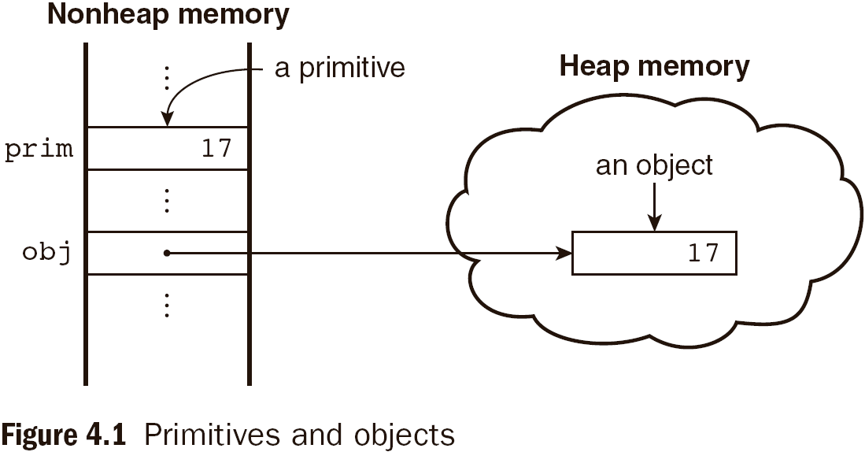
4.4 Primitive and Object Storage

Slide 18
4.4 Numeric and String Literals
Number values are represented internally as double-precision floating-point values.
This format stores numbers in 64 bits, where the number (the fraction) is stored in bits 0 to 51, the exponent in bits 52 to 62, and the sign in bit 63
  Number literals can be either integer or float
  Float values may have a decimal and/or exponent
  eg: 12 1.2 .12 12. 1E2 1e2 .1e2 1.e2 1.2E-2
  These can also be written in hex form by preceding their first digit with 0x or OX.
A String literal is delimited by either single or double quotes
  There is no difference between single and double quotes
  Certain characters may be escaped in strings
    \’ or \” to use a quote in a string delimited by the same quotes
    \\ to use a literal backspace
  The empty string ‘’ or “” has no characters

Slide 19
4.4 Other Primitive Types
Null
  A single value, null
  null is a reserved word
  A variable that is used but has not been declared nor been assigned a value has a null value
  Using a null value usually causes an error
Undefined
  A single value, undefined
  However, undefined is not, itself, a reserved word
  The value of a variable that is declared but not assigned a value
Boolean
  Two values: true and false

Slide 20
4.4 Declaring Variables
JavaScript is dynamically typed, that is, variables do not have declared types
  A variable can hold different types of values at different times during program execution
A variable can be declared either by assigning it a value or by listing it in a declaration statement that begins with a keyword var
  var counter,
  index,
  pi = 3.14159265,
  quarterback = "Elway",
  stop_flag = true;

Slide 21
4.4 Numeric Operators
Standard arithmetic
  + * - / %
Increment and decrement
  -- ++
  Increment and decrement differ in effect when used before and after a variable
  Assume that a has the value 3, initially
  (++a) * 3 has the value 24
  (a++) * 3 has the value 27
  a has the final value 8 in either case

Slide 22
4.4 Precedence of Operators
Operators | Associativity
++, --, unary - | Right
*, /, % | Left
+, - | Left
>, <, >= ,<= | Left
==, != | Left
===,!== | Left
&& | Left
|| | Left
=, +=, -=, *=, /=, &&=, ||=, %= | Right

Slide 23
4.4 Example of Precedence
var a = 2,
b = 4,
c,
d;
c = 3 + a * b;
// * is first, so c is now 11 (not 24)
d = b / a / 2;
// / associates left, so d is now 1 (not 4)

Slide 24
4.4 The Math Object
Provides a collection of properties of Number object and methods which operate on Number objects
This includes the trigonometric functions such as sin and cos
Other methods are floor, round, max etc.
When used, the methods must be referenced through the Math object, as in Math.sin(x)

Slide 25
4.4 The Number Object
Properties
  MAX_VALUE
  MIN_VALUE
  NaN
  POSITIVE_INFINITY
  NEGATIVE_INFINITY
  PI
Operations resulting in errors return NaN
  Dividing zero by zero for example
toString() method converts a number to a string

Slide 26
4.4 String Catenation
The operation + is the string catenation operation
In many cases, other types are automatically converted to string
Example:
var str = “first”;
var str1 = str + “second”;

Slide 27
4.4 Implicit Type Conversion
JavaScript attempts to convert values in order to be able to perform operations
“August “ + 1977 causes the number to be converted to string and a concatenation to be performed
7 * “3” causes the string to be converted to a number and a multiplication to be performed
null is converted to 0 in a numeric context, undefined to NaN
0 is interpreted as a Boolean false, all other numbers are interpreted as true
The empty string is interpreted as a Boolean false, all other strings (including “0”!) as Boolean true
undefined, Nan and null are all interpreted as Boolean false

Slide 28
4.4 Explicit Type Conversion
Type conversion primarily between strings and numbers
String that contain numbers can be converted to numbers using the String constructor
Example:
var str = String(value);
Explicit conversion of string to number
  var number = Number(aString)
  var number = aString – 0
  Number in the string must not be followed by any character apart from space
Number can also be converted to string by catenating it with the empty string
parseInt and parseFloat convert the beginning of a string but do not cause an error if a non-space follows the numeric part

Slide 29
4.4 String Properties and Methods
One property: length
  Note to Java programmers, this is not a method!
Example:
var str= “george”;
var len = str.length;
Large collection of methods
Character positions in strings begin at index 0

Slide 30
4.4.11 String Methods
Method | Parameters | Result
charAt | A number | Returns the character in the String object that is at the specified position
indexOf | One-character string | Returns the position in the String object of the parameter
substring | Two numbers | Returns the substring of the String object from the first parameter position to the second
toLowerCase | None | Converts any uppercase letters in the string to lowercase
toUpperCase | None | Converts any lowercase letters in the string to uppercase

Slide 31
4.4 The typeof Operator
Returns “number” or “string” or “boolean” for primitive types
Returns “object” for an object or null
Two syntactic forms
  typeof x
  typeof(x)
If the operand is a variable which has not been assigned a value, typeof evaluates to “undefined”
typeof operator always returns a string

Slide 32
4.4 Assignment Statements
Plain assignment indicated by =
Compound assignment with
  += -= /= *= %= …
a += 7 means the same as
a = a + 7

Slide 33
4.4 The Date Object
A Date object represents a time stamp, that is, a point in time
A Date object is created with the new operator
  var now= new Date();
  This creates a Date object for the time at which it was created
The date and time properties of a Date object are in two forms: local and UTC

Slide 34
4.4 The Date Object: Methods
toLocaleString | A string of the Date information
getDate | The day of the month
getMonth | The month of the year, as a number in the range of 0 to 11
getDay | The day of the week, as a number in the range of 0 to 6
getFullYear | The year
getTime | The number of milliseconds since January 1, 1970
getHours | The number of the hour, as a number in the range of 0 to 23
getMinutes | The number of the minute, as a number in the range of 0 to 59
getSeconds | The number of the second, as a number in the range of 0 to 59
getMilliseconds | The number of the millisecond, as a number in the range of 0 to 999

Slide 35
4.5 Screen Output and Keyboard Input
Standard output for JavaScript is the same as the screen in which the content of the host XHTML document is displayed
JavaScript models the XHTML document with the Document object.
The write method of the Document object writes its parameters to the browser window
If a line break is needed in the output, use <br /> into the output

Slide 36
4.5 Window and Document
The Window object represents the window in which the document containing the script is being displayed
The Document object represents the document being displayed using DOM
Window has two properties
  window refers to the Window object itself
  document refers to the Document object
The Window object is the default object for JavaScript, so properties and methods of the Window object may be used without qualifying with the class name

Slide 37
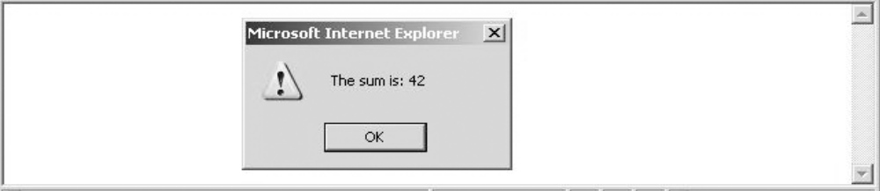
4.5 The alert Method
The alert method opens a dialog box with a message
The output of the alert is not XHTML, so use new lines rather than <br/>
alert("The sum is:" + sum + "\n");

Slide 38
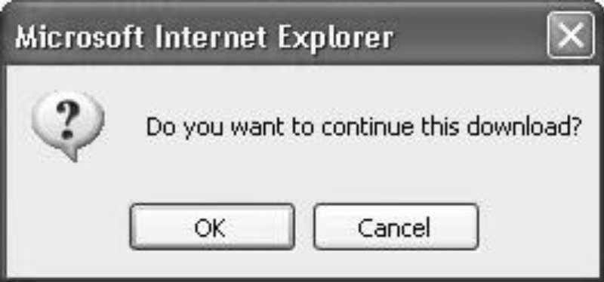
4.5 The confirm Method
The confirm methods displays a message provided as a parameter
  The confirm dialog has two buttons: OK and Cancel
If the user presses OK, true is returned by the method
If the user presses Cancel, false is returned
var question =
confirm("Do you want to continue this download?");

Slide 39
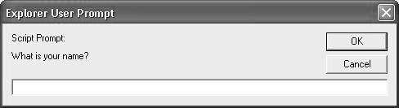
4.5 The prompt Method
This method displays its string argument in a dialog box
  A second argument provides a default content for the user entry area
The dialog box has an area for the user to enter text
The method returns a String with the text entered by the user
name = prompt("What is your name?", "");

Slide 40
4.6 Control Statements
A compound statement in JavaScript is a sequence of 0 or more statements enclosed in curly braces
  Compound statements can be used as components of control statements allowing multiple statements to be used where, syntactically, a single statement is specified
A control construct is a control statement including the statements or compound statements that it contains

Slide 41
4.6 Control Expressions
A control expression has a Boolean value
  An expression with a non-Boolean value used in a control statement will have its value converted to Boolean automatically
Comparison operators
  == != < <= > >=
  === compares identity of values or objects
  3 == ‘3’ is true due to automatic conversion
  3 === ‘3’ is false
Boolean operators
  && || !
Warning! A Boolean object evaluates as true
  Unless the object is null or undefined

Slide 42
4.6 Selection Statements
The if-then and if-then-else are similar to that in other programming languages, especially C/C++/Java

Slide 43
4.6 switch Statement Syntax
switch (expression) {
case value_1:
// statement(s)
case value_2:
// statement(s)
...
[default:
// statement(s)]
}

Slide 44
4.6 switch Statement Semantics
The expression is evaluated
The value of the expressions is compared to the value in each case in turn
If no case matches, execution begins at the default case
Otherwise, execution continues with the statement following the case
Execution continues until either the end of the switch is encountered or a break statement is executed

Slide 45
4.6 Loop Statements
Loop statements in JavaScript are similar to those in C/C++/Java
While
  while (control expression)
  statement or compound statement
For
  for (initial expression; control expression; increment expression)
  statement or compound statement
do/while
  do statement or compound statement
  while (control expression)

Slide 46
4.6 date.js Example
Uses Date objects to time a calculation
Displays the components of a Date object
Illustrates a for loop

Slide 47
4.6 while Statement Semantics
The control expression is evaluated
If the control expression is true, then the statement is executed
These two steps are repeated until the control expression becomes false
At that point the while statement is finished

Slide 48
4.6 for Statement Semantics
The initial expression is evaluated
The control expression is evaluated
If the control expression is true, the statement is executed
Then the increment expression is evaluated
The previous three steps are repeated as long as the control expression remains true
When the control expression becomes false, the statement is finished executing

Slide 49
4.6 do/while Statement Semantics
The statement is executed
The control expression is evaluated
If the control expression is true, the previous steps are repeated
This continues until the control expression becomes false
At that point, the statement execution is finished

